Slide 1
Domain ML
Technology: Python
Detection of Anomalous Behavior of Smartphone Devices using Change Point Analysis & Machine Learning

Slide 2
ABSTRACT
Security, reliability, and availability have become three fundamental characteristics that smartphones and IoT (Internet of Things) devices have to possess to provide end-users a trustworthy experience. These properties can be degraded by extraneous events or anomalous behavior provoking damage in hardware, changes in software, theft of user information, and impact of device performance in terms of speed or availability. Considering these facts, this paper focuses on anomaly detection on smartphones using their power consumption signals. These signals represent the dynamic behavior of the device due to the action of different hardware components controlled by one or many applications at the same time. This behavior can be seen as a non-stationary process due to the changes in time of its statistical properties. Considering this assumption, our methodology uses a feature extraction technique that is based on changepoint detection theory. Then, it fits three machine learning classifiers to inject diversity and maximize the detection performance. The methodology was validated on a dataset of an emulated malware running in the background of a smartphone. Our results have been compared with several power signal based approaches demonstrating that the proposed technique performs better in terms of detection accuracy.
Keywords: Anomalous Behaviour, Decision tree, XGBoosting and AdaBoost Classifiers and Support Vector Classifier.

Slide 3
INTRODUCTION
In recent years, the Internet of Things (IoT) market is witnessing an explosion in the number of devices connected and to be connected. It is expected that by 2020 the number of devices will reach ∼50 billion. A significant percentage of these devices are smartphones. According to Statista in 2019, there are approximately 2.7 billion smartphone users around the world. A common characteristic of IoT devices and smartphones is the continuous necessity for Internet access through wireless communication systems to transmit sensitive and private information of users. For this reason, these devices have been of interest to cybercriminals who have developed applications with malicious code to steal passwords, emails, contacts, photos, recordings, health insights, or another valuable user information. Furthermore, other cybercriminals have focused their efforts to degrade and harm the performance of the infrastructure of cellular, private, and public networks converting IoT devices into botnets to provoke denial of service of these networks. To counter such malicious activities, researchers, companies, and even governments have been developing different methodologies. Most of these approaches are based on analyzing the static characteristics of the applications’ source code. A disadvantage of this strategy is that these methods are susceptible to obfuscation and modification of the code to avoid being detected. Thus, other researchers have been developing methodologies in which they analyze the dynamic characteristics of the device such as network traffic, power consumption, Central Processing Unit (CPU) activity, and temperature while applications are running

Slide 4
The present work proposes a novel methodology to decide if a smartphone is running a malicious application using the power consumption of the device. The hypothesis is that the power consumed by a device contains encoded and useful information that can be used to identify the presence of malwares. That is due to the fact that when a malware is installed in a device, it must perform some activities that depicts the combination of the energy consumed for each of the hardware components of the device such as CPU, network components, screen, Global Positioning System (GPS), accelerometers, or other components. This methodology uses offline processing technique and off-device measurement in which an external device is used to collect the power consumption to improve the resolution of the power traces assuming that important features can be embedded in very short periods of time. Furthermore, we use the theory of changepoint detection to extract features of a non-stationary time series signal. The features extracted by this theory have been used as the input to a classifier to define a binary classification problem applying different machine learning techniques.

Slide 5
LITERATURE SURVEY
[1] D. Evans, “The internet of things: How the next evolution of the internet is changing everything,” CISCO white paper, Tech. Rep., 2011.
Nowadays, we experience an abundance of Internet of Things middleware solutions that make the sensors and the actuators are able to connect to the Internet. These solutions, referred to as platforms to gain a widespread adoption, have to meet the expectations of different players in the IoT ecosystem, including devices. Low cost devices are easily able to connect wirelessly to the Internet, from handhelds to coffee machines, also known as Internet of Things (IoT). This research describes the methodology and the development process of creating an IoT platform. This paper also presents the architecture and implementation for the IoT platform. The goal of this research is to develop an analytics engine which can gather sensor data from different devices and provide the ability to gain meaningful information from IoT data and act on it using machine learning algorithms. The proposed system is introducing the use of a messaging system to improve the overall system performance as well as provide easy scalability.

Slide 6
[2] Statista, “Number of mobile phone users worldwide from 2015 to 2020 (in billions).” [Online]. Available: https://www.statista.com/statistics/274774/forecast-ofmobile-phone-users-worldwide/.
The advancement of virtual reality has sharpened the concept of augmented reality (AR) to new dimension of perceptions of seeing, hearing and immersing in a real world. The evolution of mobile devices has pioneered AR as a state-of-the-art technology in the last decade giving rise to more and more location-based mobile AR (LBMAR) systems. However, notably there are very limited review studies that have focused on investigating factors such as: growth, types, characteristics, features, sensors, application domains and their respective challenges. This study presents a systematic review on location-based mobile augmented reality (LBMAR) system. A total of 35 studies published between the years 2013 and 2018 in top six most popular indexed databases are reviewed. The systematic review has been conducted using Kitchenham method, and the analysis of the findings was carried out using the PRISMA method. This chapter provides a major review of the current state of LBMAR system and outlines the research issues that require more investigation.

Slide 7
[3] A. Arabo and B. Pranggono, “Mobile malware and smart device security: Trends, challenges and solutions,” in 2013 19th International Conference on Control Systems and Computer Science, May 2013, pp. 526–531.
This work is part of the research to study trends and challenges of cyber security to smart devices in smart homes. We have seen the development and demand for seamless interconnectivity of smart devices to provide various functionality and abilities to users. While these devices provide more features and functionality, they also introduce new risks and threats. Subsequently, current cyber security issues related to smart devices are discussed and analyzed. The paper begins with related background and motivation. We identified mobile malware as one of the main issue in the smart devices’ security. In the near future, mobile smart device users can expect to see a striking increase in malware and notable advancements in malware-related attacks, particularly on the Android platform as the user base has grown exponentially. We discuss and analyzed mobile malware in details and identified challenges and future trends in this area. Then we propose and discuss an integrated security solution for cyber security in smart devices to tackle the issue.

Slide 8
[4] T. Kim, B. Kang, M. Rho, and et. all, “A multimodal deep learning method for android malware detection using various features,” IEEE Trans. on Info. Forensics and Security, vol. 14, no. 3, 2019.
With the widespread use of smartphones, the number of malware has been increasing exponentially. Among smart devices, Android devices are the most targeted devices by malware because of their high popularity. This paper proposes a novel framework for Android malware detection. Our framework uses various kinds of features to reflect the properties of Android applications from various aspects, and the features are refined using our existence-based or similarity-based feature extraction method for effective feature representation on malware detection. Besides, a multimodal deep learning method is proposed to be used as a malware detection model. This paper is the first study of the multimodal deep learning to be used in the Android malware detection. With our detection model, it was possible to maximize the benefits of encompassing multiple feature types. To evaluate the performance, we carried out various experiments with a total of 41,260 samples. We compared the accuracy of our model with that of other deep neural network models. Furthermore, we evaluated our framework in various aspects including the efficiency in model updates, the usefulness of diverse features, and our feature representation method. In addition, we compared the performance of our framework with those of other existing methods including deep learning based methods.

Slide 9
[5] Y.-S. Yen and H.-M. Sun, “An android mutation malware detection based on deep learning using visualization of importance from codes,” Microelectronics Reliability, vol. 93, pp. 109–114, 2019.
The rapid proliferation of Android malware is challenging the classification of the Android malware family. The traditional static method for classification is easily affected by the confusion and reinforcement, while the dynamic method is expensive in computation. To solve these problems, this paper proposes an Android malware familial classification method based on Dalvik Executable (DEX) file section features. First, the DEX file is converted into RGB (Red/Green/Blue) image and plain text respectively, and then, the color and texture of image and text are extracted as features. Finally, a feature fusion algorithm based on multiple kernel learning is used for classification. In this experiment, the Android Malware Dataset (AMD) was selected as the sample set. Two different comparative experiments were set up, and the method in this paper was compared with the common visualization method and feature fusion method. The results show that our method has a better classification effect with precision, recall and F1 score reaching 0.96. Besides, the time of feature extraction in this paper is reduced by 2.999 seconds compared with the method of frequent subsequence. In conclusion, the method proposed in this paper is efficient and precise in the classification of the Android malware family.

Slide 10
EXISTING SYSTEM
In the existing system, implementation of machine learning algorithms is bit complex to build due to the lack of information about the data visualization. Mathematical calculations are used in existing system for model building this may takes the lot of time and complexity. To overcome all this, we use machine learning packages available in the scikit-learn library.
Disadvantages:
High complexity.
Time consuming.

Slide 11
PROPOSED SYSTEM
Proposed several machine learning models to classify whether there is foodborne disease or not , but none have adequately addressed this misdiagnosis problem. Also, similar studies that have proposed models for evaluation of such performance classification mostly do not consider the heterogeneity and the size of the data Therefore, we propose a Disease, Random Forest, Decission Tree, Gradient Boosting and AdaBoost Classifier to predict.
Advantages:
Highest accuracy
Reduces time complexity.
Easy to use

Slide 12
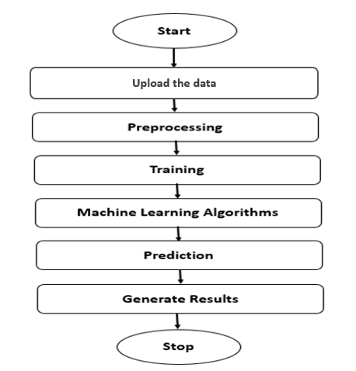
PROPOSED METHOD

Slide 13
1. Decision Tree Classifier:
A tree has many analogies in real life, and turns out that it has influenced a wide area of machine learning, covering both classification and regression. In decision analysis, a decision tree can be used to visually and explicitly represent decisions and decision making. As the name goes, it uses a tree-like model of decisions. Though a commonly used tool in data mining for deriving a strategy to reach a particular goal.
A decision tree is drawn upside down with its root at the top. In the image on the left, the bold text in black represents a condition/internal node, based on which the tree splits into branches/ edges. The end of the branch that doesn’t split anymore is the decision/leaf, in this case, whether the passenger died or survived, represented as red and green text respectively.
Although, a real dataset will have a lot more features and this will just be a branch in a much bigger tree, but you can’t ignore the simplicity of this algorithm. The feature importance is clear and relations can be viewed easily. This methodology is more commonly known as learning decision tree from data and above tree is called Classification tree as the target is to classify passenger as survived or died. Regression trees are represented in the same manner, just they predict continuous values like price of a house. In general, Decision Tree algorithms are referred to as CART or Classification and Regression Trees.

Slide 14
2. AdaBoost Classifier:
AdaBoost algorithm, short for Adaptive Boosting, is a Boosting technique used as an Ensemble Method in Machine Learning. It is called Adaptive Boosting as the weights are re-assigned to each instance, with higher weights assigned to incorrectly classified instances. Boosting is used to reduce bias as well as variance for supervised learning. It works on the principle of learners growing sequentially. Except for the first, each subsequent learner is grown from previously grown learners. In simple words, weak learners are converted into strong ones. The AdaBoost algorithm works on the same principle as boosting with a slight difference. Let’s discuss this difference in detail.
First, let us discuss how boosting works. It makes ‘n’ number of decision trees during the data training period. As the first decision tree/model is made, the incorrectly classified record in the first model is given priority. Only these records are sent as input for the second model. The process goes on until we specify a number of base learners we want to create. Remember, repetition of records is allowed with all boosting techniques.

Slide 15
3. XGBoosting Classifier:
XGBoost stands for “Extreme Gradient Boosting”. XGBoost is an optimized distributed gradient boosting library designed to be highly efficient, flexible and portable. It implements Machine Learning algorithms under the Gradient Boosting framework. It provides a parallel tree boosting to solve many data science problems in a fast and accurate way.
Boosting
Boosting is an ensemble learning technique to build a strong classifier from several weak classifiers in series. Boosting algorithms play a crucial role in dealing with bias-variance trade-off. Unlike bagging algorithms, which only controls for high variance in a model, boosting controls both the aspects (bias & variance) and is considered to be more effective.
Below are the few types of boosting algorithms:
• AdaBoost (Adaptive Boosting)
• Gradient Boosting
• XGBoost
• CatBoost

Slide 16
XGBoost stands for eXtreme Gradient Boosting. It became popular in the recent days and is dominating applied machine learning and Kaggle competitions for structured data because of its scalability.
XGBoost is an extension to gradient boosted decision trees (GBM) and specially designed to improve speed and performance.
XGBoost Features
• Regularized Learning: Regularization term helps to smooth the final learnt weights to avoid over-fitting. The regularized objective will tend to select a model employing simple and predictive functions.
• Gradient Tree Boosting: The tree ensemble model cannot be optimized using traditional optimization methods in Euclidean space. Instead, the model is trained in an additive manner.
• Shrinkage and Column Subsampling: Besides the regularized objective, two additional techniques are used to further prevent over fitting. The first technique is shrinkage introduced by Friedman. Shrinkage scales newly added weights by a factor η after each step of tree boosting. Similar to a learning rate in stochastic optimization, shrinkage reduces the influence of each tree and leaves space for future trees to improve the model.

Slide 17
4. Support Vector Classifier:
The objective of the support vector machine algorithm is to find a hyper plane in an N-dimensional space (N — the number of features) that distinctly classifies the data points.
Possible hyper planes :
To separate the two classes of data points, there are many possible Hyper planes that could be chosen. Our objective is to find a plane that has the maximum margin, i.e. the maximum distance between data points of both classes. Maximizing the margin distance provides some reinforcement so that future data points can be classified with more confidence.
Hyper planes and Support Vectors
Hyper planes in 2D and 3D feature space
Hyper planes are decision boundaries that help classify the data points. Data points falling on either side of the hyper plane can be attributed to different classes. Also, the dimension of the hyper plane depends upon the number of features. If the number of input features is 2, then the hyper plane is just a line. If the number of input features is 3, then the hyper plane becomes a two-dimensional plane. It becomes difficult to imagine when the number of features exceeds 3.

Slide 18
Support vectors are data points that are closer to the hyper plane and influence the position and orientation of the hyper plane. Using these support vectors, we maximize the margin of the classifier. Deleting the support vectors will change the position of the hyper plane. These are the points that help us build our SVM.
Large Margin Intuition
In logistic regression, we take the output of the linear function and squash the value within the range of [0,1] using the sigmoid function. If the squashed value is greater than a threshold value (0.5) we assign it a label 1, else we assign it a label 0. In SVM, we take the output of the linear function and if that output is greater than 1, we identify it with one class and if the output is -1, we identify is with another class. Since the threshold values are changed to 1 and -1 in SVM, we obtain this reinforcement range of values ([-1, 1]) which acts as margin.

Slide 19
HARDWARE AND SOFTWARE REQUIREMENTS
H/W Configuration:
Operating system : Windows 7 or 7+
RAM : 8 GB
Hard disc or SSD : More than 500 GB
Processor : Intel 3rd generation or high or Ryzen with 8 GB Ram
S/W Configuration:
Software’s : Python 3.6 or high version
IDE : PyCharm.
Framework : Flask

Slide 20
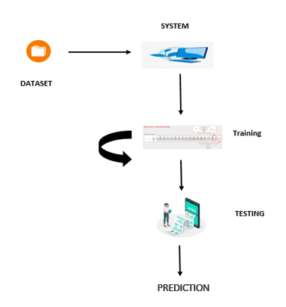
ARCHIECTURE

Slide 21
UML DIAGRAMS
UML stands for Unified Modelling Language. UML is a standardized general-purpose modelling language in the field of object-oriented software engineering. The standard is managed, and was created by, the Object Management Group.
The goal is for UML to become a common language for creating models of object-oriented computer software. In its current form UML is comprised of two major components: a Meta-model and a notation. In the future, some form of method or process may also be added to; or associated with, UML.
The Unified Modelling Language is a standard language for specifying, Visualization, Constructing and documenting the artefacts of software system, as well as for business modelling and other non-software systems. The UML represents a collection of best engineering practices that have proven successful in the modelling of large and complex systems.
The UML is a very important part of developing objects-oriented software and the software development process. The UML uses mostly graphical notations to express the design of software projects.

Slide 22
GOALS:
The Primary goals in the design of the UML are as follows:
Provide users a ready-to-use, expressive visual modelling Language so that they can develop and exchange meaningful models.
Provide extendibility and specialization mechanisms to extend the core concepts.
Be independent of particular programming languages and development process.
Provide a formal basis for understanding the modelling language.
Encourage the growth of OO tools market.
Support higher level development concepts such as collaborations, frameworks, patterns and components.
Integrate best practices.

Slide 23
USE CASE DIAGRAM
A use case diagram in the Unified Modeling Language (UML) is a type of behavioral diagram defined by and created from a Use-case analysis.
Its purpose is to present a graphical overview of the functionality provided by a system in terms of actors, their goals (represented as use cases), and any dependencies between those use cases.
The main purpose of a use case diagram is to show what system functions are performed for which actor. Roles of the actors in the system can be depicted.

Slide 24
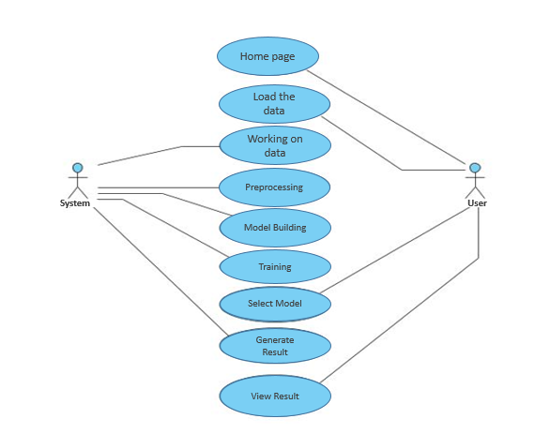

Slide 25
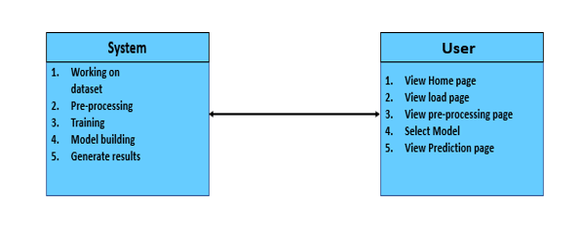
CLASS DIAGRAM
In software engineering, a class diagram in the Unified Modeling Language (UML) is a type of static structure diagram that describes the structure of a system by showing the system's classes, their attributes, operations (or methods), and the relationships among the classes. It explains which class contains information

Slide 26
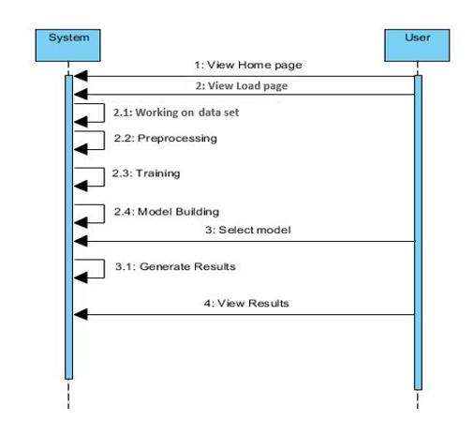
SEQUENCE DIAGRAM
A sequence diagram in Unified Modeling Language (UML) is a kind of interaction diagram that shows how processes operate with one another and in what order.
It is a construct of a Message Sequence Chart. Sequence diagrams are sometimes called event diagrams, event scenarios, and timing diagrams

Slide 27
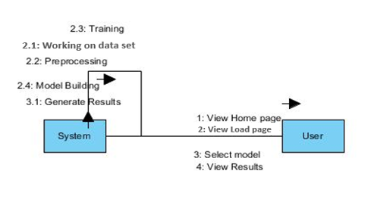
COLLABORATION DIAGRAM:
In collaboration diagram the method call sequence is indicated by some numbering technique as shown below. The number indicates how the methods are called one after another. We have taken the same order management system to describe the collaboration diagram. The method calls are similar to that of a sequence diagram. But the difference is that the sequence diagram does not describe the object organization whereas the collaboration diagram shows the object organization.

Slide 28
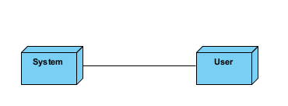
DEPLOYMENT DIAGRAM
Deployment diagram represents the deployment view of a system. It is related to the component diagram. Because the components are deployed using the deployment diagrams. A deployment diagram consists of nodes. Nodes are nothing but physical hardware’s used to deploy the application.

Slide 29
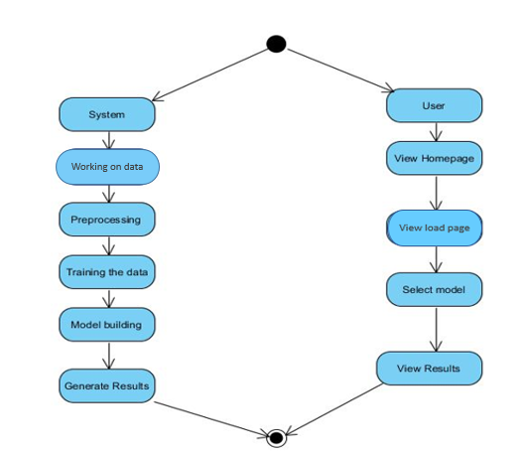
ACTIVITY DIAGRAM:
Activity diagrams are graphical representations of workflows of stepwise activities and actions with support for choice, iteration and concurrency. In the Unified Modelling Language, activity diagrams can be used to describe the business and operational step-by-step workflows of components in a system. An activity diagram shows the overall flow of control.

Slide 30
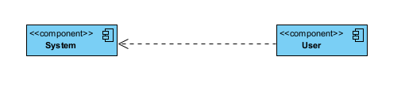
COMPONENT DIAGRAM:
A component diagram, also known as a UML component diagram, describes the organization and wiring of the physical components in a system. Component diagrams are often drawn to help model implementation details and double-check that every aspect of the system's required function is covered by planned development.

Slide 31
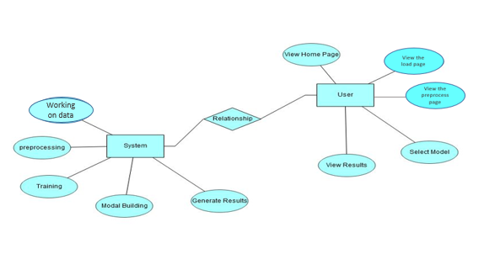
ER DIAGRAM:
An Entity–relationship model (ER model) describes the structure of a database with the help of a diagram, which is known as Entity Relationship Diagram (ER Diagram). An ER model is a design or blueprint of a database that can later be implemented as a database. The main components of E-R model are: entity set and relationship set.
An ER diagram shows the relationship among entity sets. An entity set is a group of similar entities and these entities can have attributes. In terms of DBMS, an entity is a table or attribute of a table in database, so by showing relationship among tables and their attributes, ER diagram shows the complete logical structure of a database. Let’s have a look at a simple ER diagram to understand this concept.

Slide 32
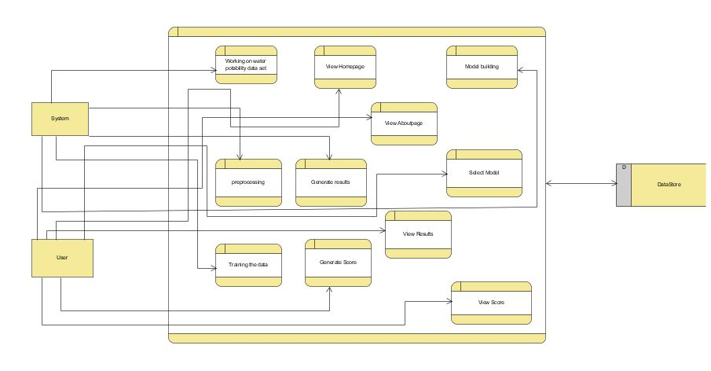
DFD DIAGRAM:
A Data Flow Diagram (DFD) is a traditional way to visualize the information flows within a system. A neat and clear DFD can depict a good amount of the system requirements graphically. It can be manual, automated, or a combination of both. It shows how information enters and leaves the system, what changes the information and where information is stored. The purpose of a DFD is to show the scope and boundaries of a system as a whole. It may be used as a communications tool between a systems analyst and any person who plays a part in the system that acts as the starting point for redesigning a system.

Slide 33
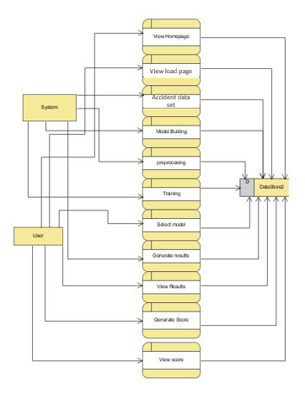

Slide 34
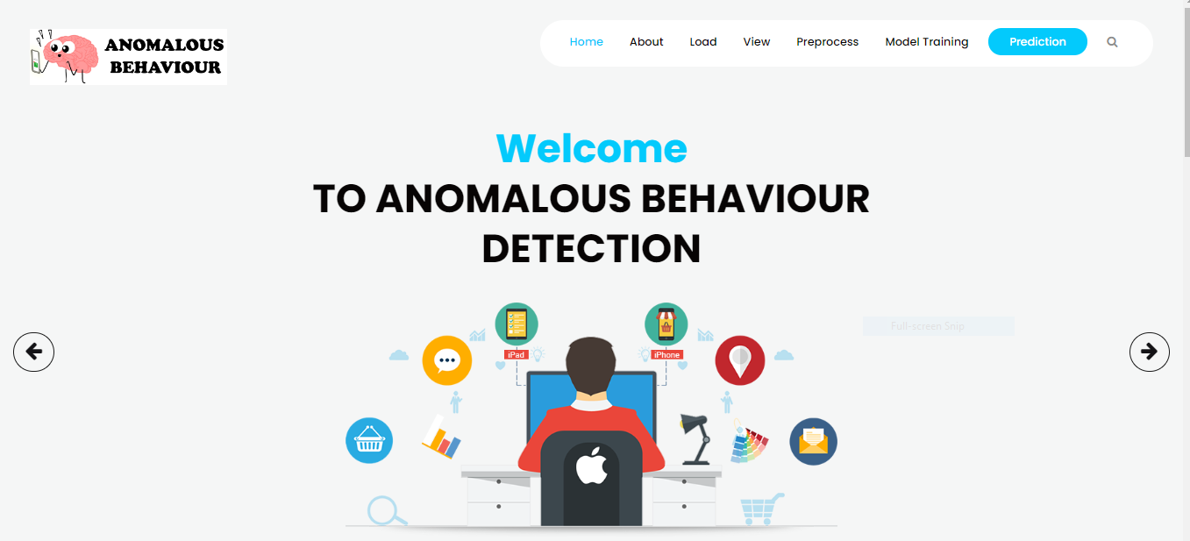
OUTPUT SCREEN SHOTS WITH DESCRIPTION.
Home Page:
Here user view the home page of hate anomalous behaviour detection web application.

Slide 35
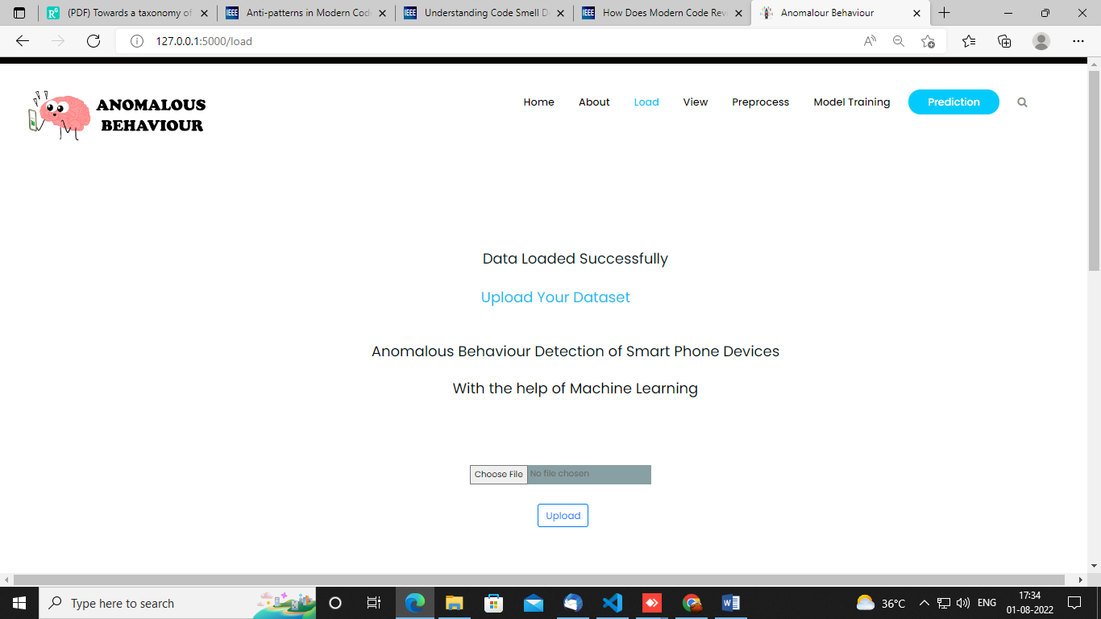
Load:
In the load page, users can load the anomalous dataset.

Slide 36
View:
Here we can see the uploaded data set.

Slide 37
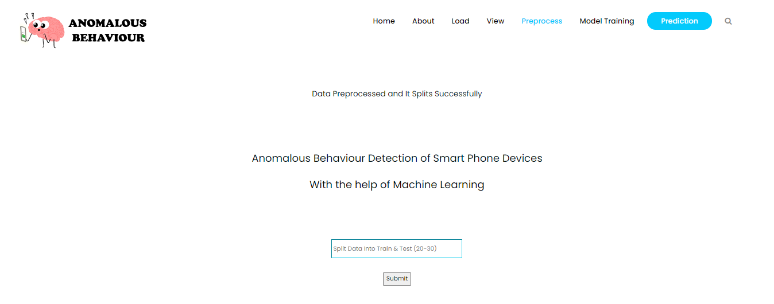
Pre-process:
Here we can prepare our data in such a way that our system can understand means we will make our data noise free over here.

Slide 38
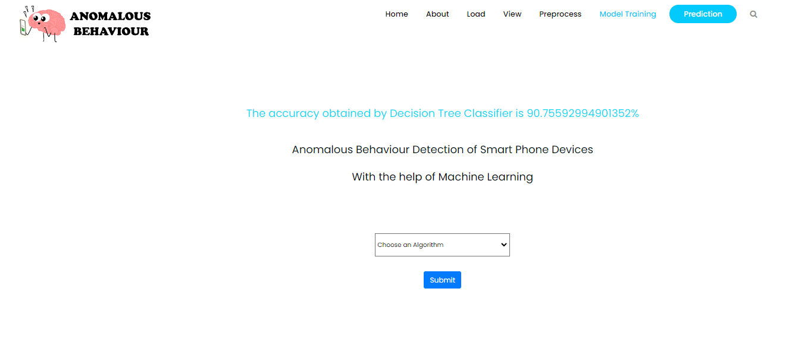
Model:
Here we can train our data using different algorithm.

Slide 39
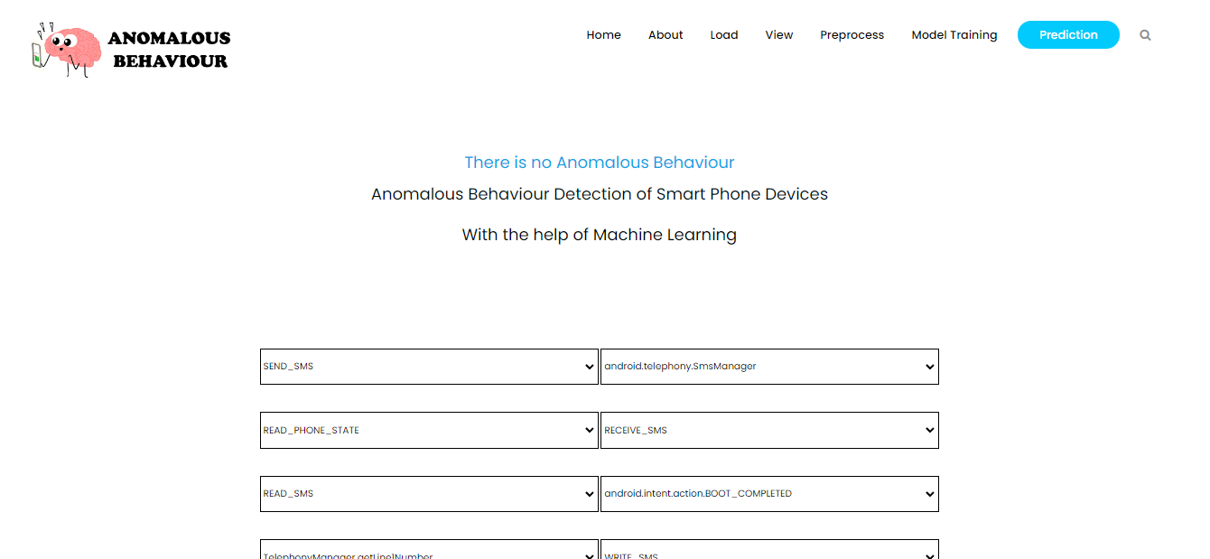
Prediction:
This page show the detection result of the foodborne disease prediction data.

Slide 40
CONCLUSION:
In this paper, we proposed a new methodology to identify when smartphone applications behave anomalously. The work considers the use of a changepoint detection theory to extract features and three machine learning techniques to train a classifier from the power consumed by the smartphone. We can conclude that the proposed methodology performs better in terms of F1-measure accuracy comparing it with three other methodologies. We can emphasize that our methodology can recognize malware acting in short periods of time which it was a disadvantage of the other methodologies. As a future work, we aim to apply the methodology on real malwares instead of using an emulated malware.

Slide 41
REFERENCES:
[1] D. Evans, “The internet of things: How the next evolution of the internet is changing everything,” CISCO white paper, Tech. Rep., 2011.
[2] Statista, “Number of mobile phone users worldwide from 2015 to 2020 (in billions).” [Online]. Available: https://www.statista.com/statistics/274774/forecast-ofmobile-phone-users-worldwide/
[3] A. Arabo and B. Pranggono, “Mobile malware and smart device security: Trends, challenges and solutions,” in 2013 19th International Conference on Control Systems and Computer Science, May 2013, pp. 526–531.
[4] T. Kim, B. Kang, M. Rho, and et. all, “A multimodal deep learning method for android malware detection using various features,” IEEE Trans. on Info. Forensics and Security, vol. 14, no. 3, 2019.
[5] Y.-S. Yen and H.-M. Sun, “An android mutation malware detection based on deep learning using visualization of importance from codes,” Microelectronics Reliability, vol. 93, pp. 109–114, 2019.

Slide 42
[6] D. Arp, M. Spreitzenbarth, M. Hubner, H. Gascon, K. Rieck, and C. Siemens, “Drebin: Effective and explainable detection of android malware in your pocket.” in Ndss, vol. 14, 2014, pp. 23–26.
[7] P. Faruki, A. Bharmal, V. Laxmi, and et. all, “Android security: A survey of issues, malware penetration, and defenses,” IEEE Communications Surveys Tutorials, vol. 17, no. 2, pp. 998–1022, Secondquarter 2015.
[8] K. Ariyapala, H. G. Do, H. N. Anh, and et. all, “A host and network based intrusion detection for android smartphones,” in 30th Int. Conf. on Advanced Info. Net. and Apps Workshops (WAINA), March 2016.
[9] M. Curti, A. Merlo, M. Migliardi, and S. Schiappacasse, “Towards energy-aware intrusion detection systems on mobile devices,” in Int. Conf. on High Performance Computing Simulation (HPCS), July 2013.
[10] H. Kim, J. Smith, and K. G. Shin, “Detecting energy-greedy anomalies and mobile malware variants,” in Proceedings of the 6th international conference on Mobile systems, applications, and services. ACM, 2008.

Slide 43


